Slide 1

Dept. of Methodology and Statistics Institute of Psychology Psycho- and Sociometrics Neuro-Imaging Statistical Learning & Non-Parametric Methods

Slide 2
Dept. of Methodology and Statistics Psycho- and Sociometrics Neuro-Imaging Statistical Learning & Prediction Open & Reproducible Research https://www.universiteitleiden.nl/en/social-behavioural-sciences/psychology/methodology-and-statistics

Slide 3
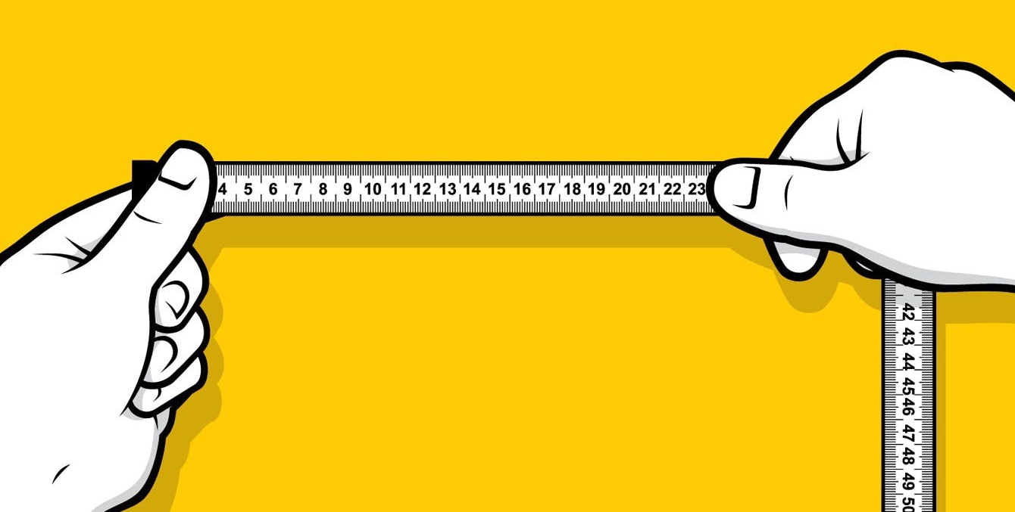
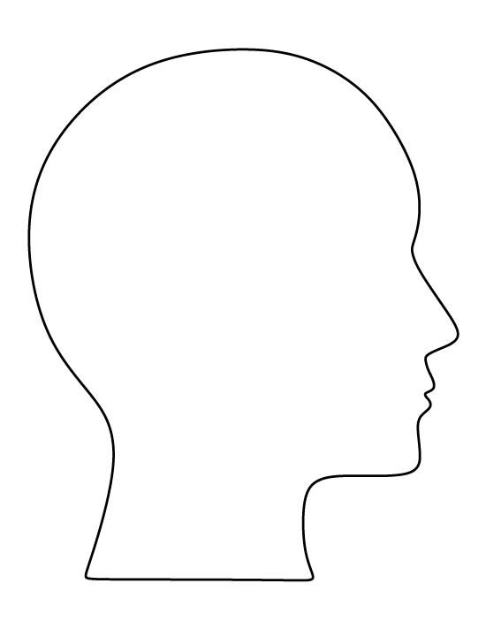
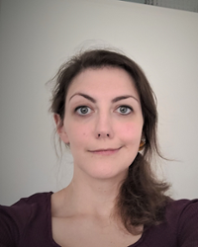
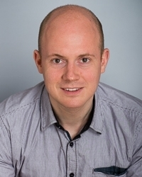
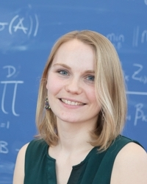
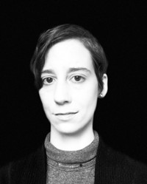
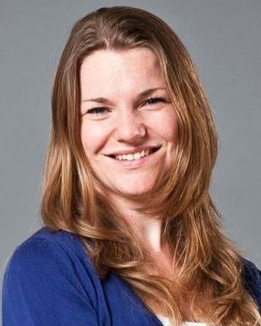
Psycho- and Sociometrics
Measuring and quantifying behavior, emotions & attitudes:
(Dr. Jaqueline Zadelaar)
Missing data (Dr. Joost van Ginkel)
Optimal scaling (Dr. Sanne Willems)
Dr. Aniko Lovik
Dr. Mathilde Verdam

Slide 4
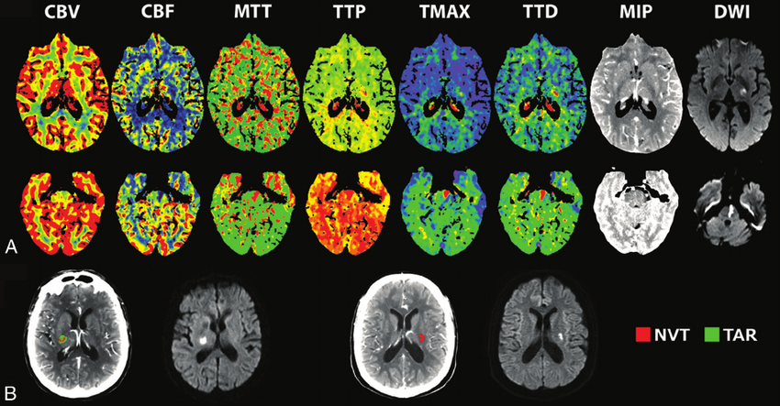
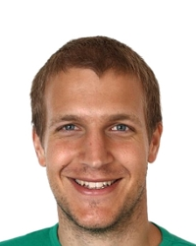
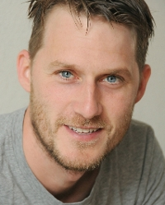
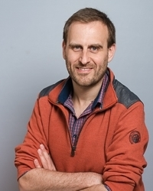
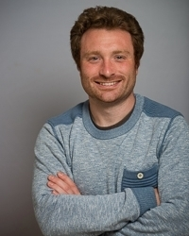
New statistical methods for neuro-imaging (EEG, (f)MRI)
Dr. Wouter Weeda
Dr. Tom Wilderjans
Dr. Sjoerd Huisman
Dr. Frank de Vos

Slide 5
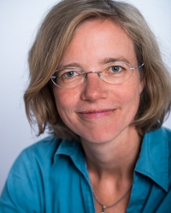
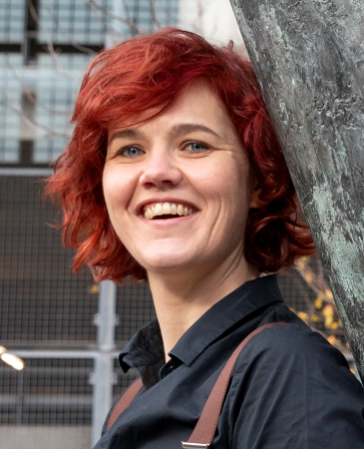
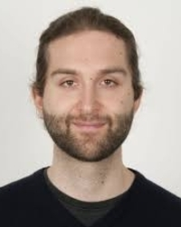
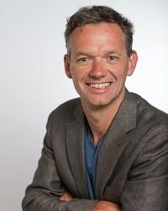
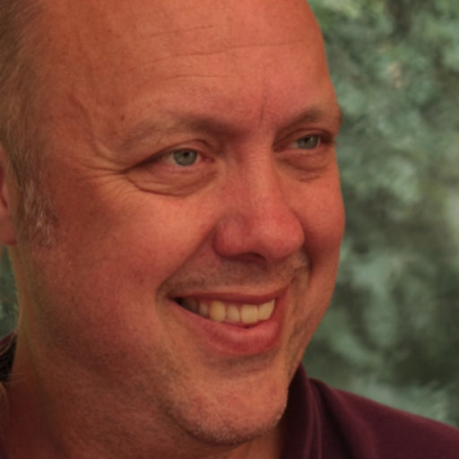
Statistical learning and prediction
Novel prediction and classification methods for high-dimensional data:
Dr. Elise Dusseldorp
Dr. Marjolein Fokkema
Dr. Julian Karch
Prof. Mark de Rooij
Dr. Frank Busing

Slide 6
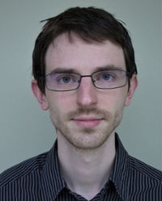
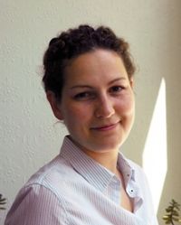
Open & Reproducible Science
Dr. Tom Heyman
Dr. Anna van ‘t Veer
Dr. Wouter Weeda

Slide 7
More information about our Unit on https://www.universiteitleiden.nl/en/social-behavioural-sciences/psychology/methodology-and-statistics
If you have a specific interest in any of these topics, you can contact one of the researchers by email
You do not have to specifically work on the proposals on Brightspace; some students come up with their own research idea
More projects will follow on BrightSpace page > Projects
Some current projects:

Slide 8
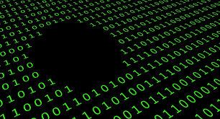
Missing data (Dr. Joost van Ginkel)
Moderated factor analysis with multiply imputed data
Model fit evauation with multiply imputed data

Slide 9
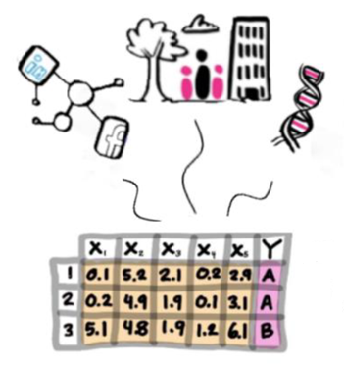
Multi-view and multi-task learning (Prof. Mark de Rooij)

Slide 10
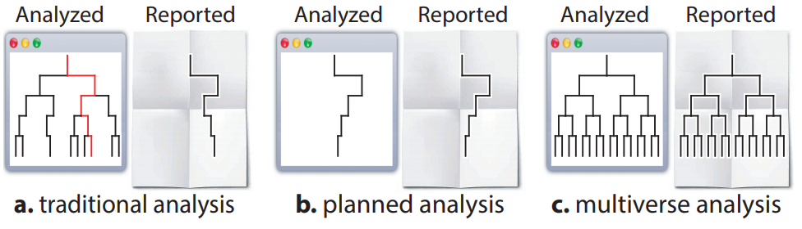
Multiverse Analyses (Dr. Tom Heyman)

Slide 11
